Slide 1
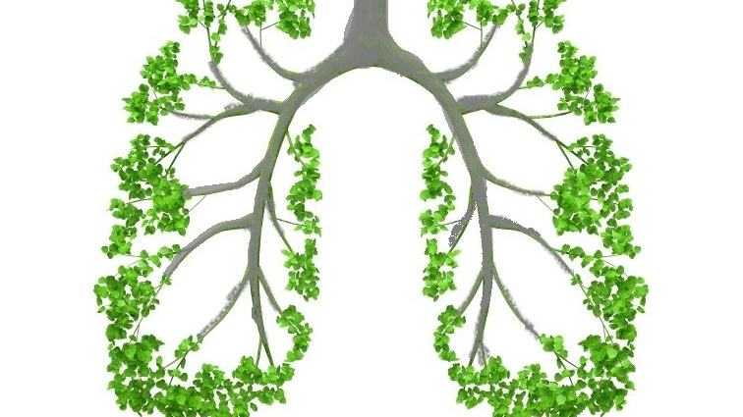
Natural Remedies for Asthma
By Tyler Karren
HW499
Kaplan University

Slide 2
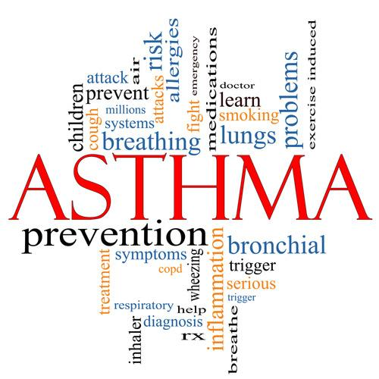
Introduction
What is asthma?
Who is affected?
What are the symptoms?
Medical treatments
Nutritional remedies
Herbal remedies
Resources
Notes:
Hello. My name is Tyler Karren. I am a family wellness coach, and I wish to spend to time with you today discussing an issue that affects individuals and families in growing numbers. The topic is asthma. In this presentation, we will discuss asthma as a health condition, who is affected by this disease, and what are the symptoms. Many asthma cases go undiagnosed, because people lack education and knowledge about this condition. Further, we will describe medical treatments for asthma and what side-effects those treatments may pose. Then we will learn about alternative and complementary methods of treating and managing asthma, which will include nutritional and herbal remedies that you could try. Lastly, I will provide valuable and reliable resources that will further your understanding of asthma and how to manage it.

Slide 3
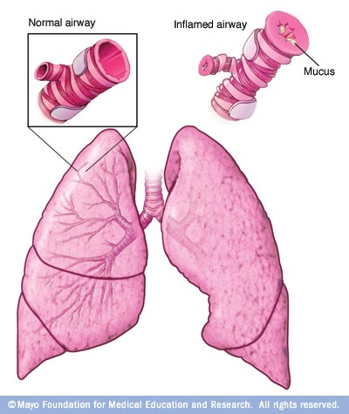
What is asthma?
Disease of the lungs in which the airways become inflamed and obstructed.
Asthma attacks are spasms in the muscles around the bronchi, the small airways of the lungs, which constrict and obstruct the outward flow of air and produce extra mucus.
Sufferers of asthma describe the sensation of an asthma attack as being starved for air. They fight to breath in and out.
Notes:
Let’s start first with defining asthma as a health condition. At a basic level, asthma is a lung disease. The airways of the lungs become inflamed and obstructed, usually by the production of extra mucus (Mayo Clinic Staff, 2017). The muscles around the bronchi, which are the small airways of the lungs, constrict and reduce the flow of air in and out of the lungs. Most people with this condition describe an asthma attack like they are being starved of air. It is very difficult for the person to breath in and out as easily as a person without asthma (Balch & Balch, 2000). I personally have asthma, and during a really bad attack, I describe it like a stack of phone books is sitting on my chest. Not only is the feeling uncomfortable, but it causes a great amount of anxiety. The picture on this slide illustrates the difference between a normal airway and an inflamed airway during an asthma attack (Mayo Clinic Staff, 2017). Is there anyone in the audience who has experienced an asthma attack or knows someone with asthma that wants to share their experience?

Slide 4
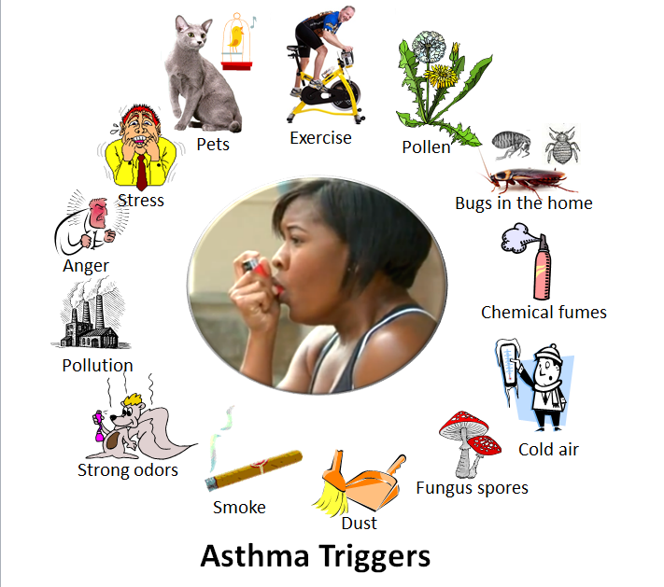
Two forms of asthma
Allergic
Asthma that is triggered by allergens or irritants.
Dander, dust mites, feathers, air pollutants, mold, tobacco smoke
Nonallergic
Asthma triggered by other sources
Exercise induced, anxiety, laughing, low blood sugar, stress
Notes:
The two most common forms of asthma are allergic and nonallergic. Looking at the illustration on this slide, you will see various kinds of triggers. Can you identify the triggers that fall within each of the two categories? Let’s shout some out. Who wants to take a shot at this? It seems fairly common sense that allergic asthma is caused by allergens or some kind of irritant. Nonallergic asthma triggers are all the other sources (Balch & Balch, 2000). For me personally, my asthma is caused by both allergic irritants and nonallergic triggers. I am very allergic to dogs. Whenever I am around dogs, I get hives and an asthma attack shortly follows. I also experience asthma symptoms when I exercise.

Slide 5
Who is affected?
Children under the age of 16, particularly those who live in urban areas
Adults over the age of 65 are at risk
Those who have siblings, parents, or grandparents with asthma
5 million children are affected
9 million adults are affected
#1 cause of hospitalization for kids
Notes:
The incidence of asthma cases is growing at an alarming rate. Since 1980, we have seen a 75% increase in asthma cases nationwide. But if you look at just children, the incidences have increase by 160% (Balch & Balch, 2000). Let’s talk about who is affected by asthma and who is at risk. It should be no surprise that children are affected. Those under 16 years of age, especially if they live in urban areas, have been seen to develop asthma. Adults over the age of 65 are at risk of getting asthma, too. These two groups are the most likely to suffer from asthma out of all of the population groups. In 1999, a hereditary link to asthma was discovered by researchers. This means that if you have siblings, or other family members with asthma, you have a greater risk of having it, too. This may explain why the rate of asthma has exploded over the past couple decades (Balch & Balch, 2000). Across the country, 5 million kids suffer from asthma, as does 9 million adults. We can expect these numbers to continue to climb. Research has shown that the number one reason for hospitalization of children is due to asthma related issues (Balch & Balch, 2000).

Slide 6
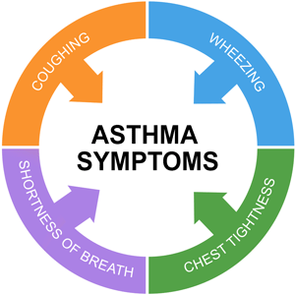
What are the symptoms?
Severe asthma attacks can be life-threatening. Seek immediate treatment.
Notes:
The main symptoms of asthma are coughing, wheezing shortness of breath, and tightness or pain in the chest (Mayo Clinic Staff, 2017). During a really bad asthma attack, I could personally describe the feeling as a stack of phonebooks sitting on my chest. Further symptoms could include trouble sleeping due to cough or wheezing and worsening of all of these symptoms during a respiratory virus, such as a cold or flu (Mayo Clinic Staff, 2017). For those with exercise induced asthma, flare-ups can occur when the air is cold and dry. Those who suffer from allergy induced asthma, spring and summer can be prime time for flare-ups due to pollen and other irritants in the air (Mayo Clinic Staff, 2017). It is important to understand, especially to those of you knew to asthma, that severe attacks can be life-threatening. If you find yourself or someone else having a severe attack, seek immediate medical treatment. Ideally, we want to help prevent asthma attacks and learn to manage asthma, not only through medical treatments, but also through herbs and supplements. This is the primary purpose of this presentation, but we needed to lay this foundation first.

Slide 7
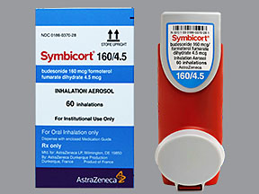
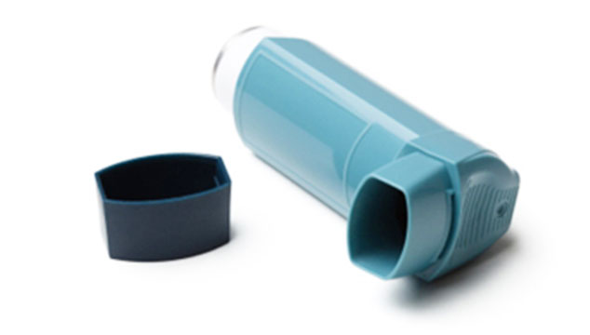
Medical treatments
Long Term Control Medications
Inhaled corticosteroids
Leukotriene modifiers
Long-acting beta agonists
Combination inhalers
Quick Relief Medications
Short-acting beta agonists
Ipratropium (Atrovent)
Oral and intravenous corticosteroids
Notes:
There are many types of drugs on the market that are designed to help treat, manage, and control asthma symptoms. From a medical standpoint, there is no medicine that can cure asthma. Because this presentation is meant to focus on natural remedies, we won’t spend too much time on this screen. But I do want to point out that natural remedies are meant to compliment medical treatments in many cases. Long term medications, such as Symbicort, prevent asthma attacks from occurring. Symbicort falls under the combination inhaler category. The quick relief medications calm a asthma attack and quickly resolve the symptoms, but they only work for a short amount of time (Mayo Clinic Staff, 2017). You can consult with a medical doctor to determine the right medication for you.

Slide 8
Nutritional remedies
Flaxseed oil
Vitamin B Complex
Notes:
There are many nutritional supplements that can aid in the management of asthma. We will look at just a few of the ones here today that can be most beneficial. Flaxseed oil is highly recommended as a source of Omega 3 fatty acids. This supplement helps in the production of anti-inflammatory prostaglandins and help form the structure of the cell membrane. The idea of using flaxseed oil is that it will help to reduce inflammation in the airways of the lungs. Consider taking 1,000 mg twice daily before meals (Balch & Balch, 2000).
Vitamin B complex supplements are another great recommendation. The B vitamins help to stimulate the immune system, help in the treatment of allergies, and decrease the inflammation in the lungs during an asthma attack. Of all the B vitamins, it is thought that B6 is the most important in managing asthma symptoms (Balch & Balch, 2000). Consider taking 50mg of each B vitamin 4 times daily, or use a potent B Complex supplement and follow the recommended dosage on the bottle (Balch & Balch, 2000).

Slide 9
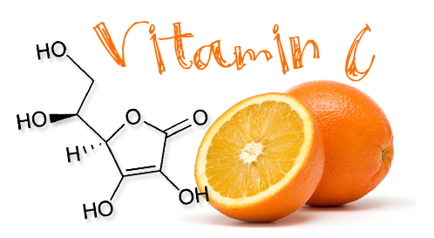
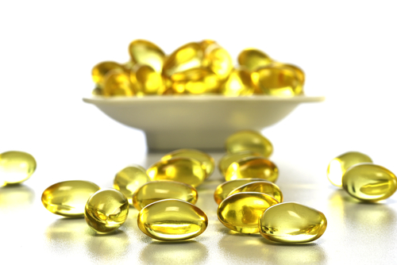
Nutritional remedies
Vitamin C
Vitamin E
Notes:
Next, let’s look at two more vitamin supplements that can help in asthma management. Vitamin C is a commonly known vitamin, most known for being found in citrus fruits. Vitamin C is important in helping to protect the lung tissue and reduce infection. It also aids in increasing air flow through the airways by fighting inflammation. Using a supplement that contains bioflavonoids is highly recommended. Consider taking 1,5000 mg 3 times a day (Balch & Balch, 2000).
Vitamin E is a potent antioxidant and has many health benefits. As an antioxidant, vitamin E can help to rid the body of free radicals and pollutants that cause inflammation that lead to asthma attacks. Recommended dosage is 600 IU daily in the form of d-alpha-tocopherol (Balch & Balch, 2000).

Slide 10
Herbal remedies
Chamomile
Green Tea
Notes:
Just like nutritional remedies, there are also a myriad of herbal remedies that can benefit those who suffer from asthma. Today we will list a few of them to get you started. Herbal supplements can come in various forms, such as capsules, tinctures, and teas. The first two herbal supplements we will discuss are recommended to be taken as tea. There are two types of chamomile, Roman and German Chamomile. It is the flowering top of the plant that is used to prepare teas. In ancient times, this was a very important herb in Egypt, Rome, and Greece (NIH, 2016). Today, I am recommending German chamomile tea, which acts as a gentle antihistamine that prevents asthma attacks. Take 1 cup of chamomile tea 2 to 3 times daily (Balch P. A., 2002).
Green tea is another powerful antioxidant supplement recommended for asthma. Green tea contains theophylline, which opens bronchial passage ways. Try taking 1 cup of green tea 2 to 3 times per day (Balch P. A., 2002). According to the NIH (2016), green tea is prepared by steaming the fresh leaves of the plant
Camellia sinensis. For millennia, green tea has been used for medicinal purposes in China and Japan. Usually this supplement is consumed as a beverage, but it can also come in capsules, extracts, and tablets.

Slide 11
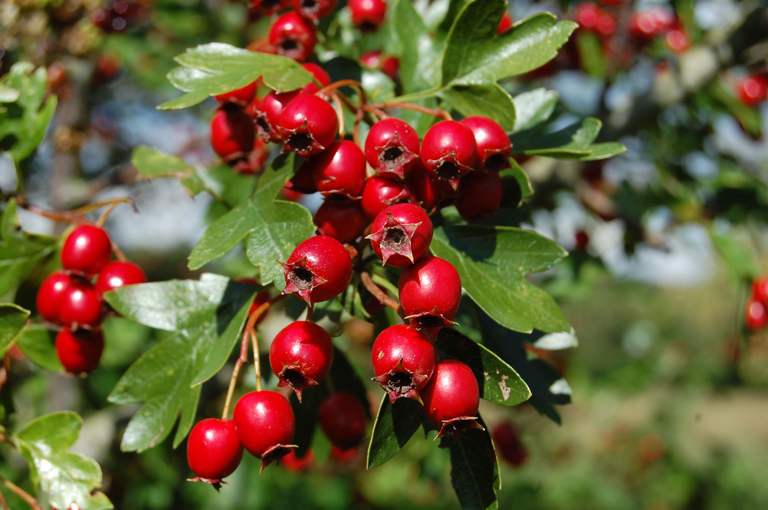
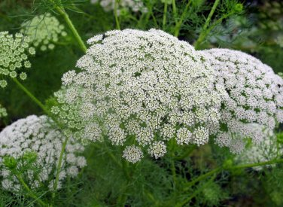
Herbal remedies
Hawthorn
Khella
Notes:
The herb hawthorn is a great supplement to take as a complimentary protocol to taking an inhaler medication. Hawthorn assists in preventing tissue damage in the liver, pancreas, and heart. Suggested dosage is 100 to 250 mg three times per day in the form of capsules or tablets (Balch P. A., 2002). Hawthorn supplements are usually made from taking extracts of the flower, leaves, or berries. In studies that looked at hawthorn use for heart issues, there were some reported side effects: dizziness, nausea, and related digestive complaints (NIH, 2016).
Taken in tincture form, Khella is an herbal remedy known to help prevent bronchial spasms. Depending on the brand, follow the dosage label and consider taking a dose every six hours (Balch P. A., 2002). WebMD confirms the use of Khella, not just in asthma, for other respiratory related issues. The medicinal benefit comes from drying the fruit and extracting a chemical called khellin and dissolving it in liquid to make a tea or tincture. It is recommended to not take Khella if you are pregnant or have liver issues (WebMD, 2016).

Slide 12
Website Resources
http://www.mayoclinic.org
ods.od.nih.gov
http://www.webmd.com
(Vitamin and Supplement Center)
Notes:
There are numerous resources on the internet that can aid you in finding remedies or suggestions for dealing with Asthma. It is important, however, to use only trusted resources that will give you evidence-based information. The National Institutes of Health has a page dedicated to providing you information on nearly every dietary supplement. For example, type in Vitamin C, and it will pull up a fact sheet about this supplement. Next, the Mayo Clinic will be a valuable jumping off point for those new to asthma or want to learn more about it. Type Asthma in the search bar to get started. WebMD also has information about vitamin and nutritional supplements. WebMD offers suggested usage and side-effects for the various types of supplements on the market. All three of these sites were used in researching information for this presentation.

Slide 13
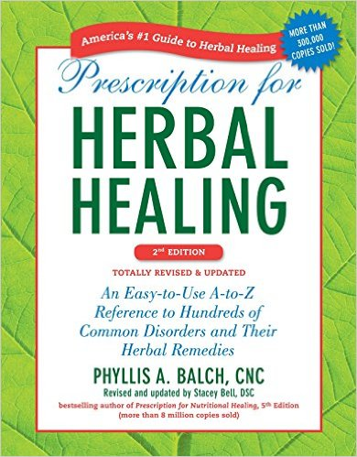
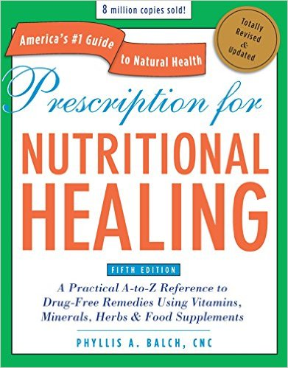
Books for your family library
Phyllis A. Balch, CNC
Notes:
The two books seen in this slide are a must have for any family home library. They are available on Amazon in paperback format, and each are several inches thick of amazing information on nutritional and herbal remedies. The author is certified nutritional consultant with decades and decades of experience counselling individuals in the field of nutritional healing (Balch P. A., 2002). The books are in an easy to use format that makes looking up specific conditions a snap. She also provides extensive information on specific remedies and the principles of healing naturally.
As we conclude this presentation today about managing asthma through natural remedies, I want to open up to any questions that anyone may have. I want to thank each of you for listening so intently to this information and I hope that it will prove to be a valuable resource to you and your family.

Slide 14
References
Balch, J. F., & Balch, P. A. (2000). Prescription for nutritional healing, 3rd Edition. New York: Penguin Putnam Inc.
Balch, P. A. (2002). Prescription for herb healing. New York: Penguin Putnam Inc.
Mayo Clinic Staff. (2017). Diseases and conditions: Asthma. Retrieved January 25, 2017, from Mayo Clinic: http://www.mayoclinic.org/diseases-conditions/asthma/basics/definition/con-20026992
NIH. (2016). Chamomile. Retrieved January 27, 2017, from National Institutes of Health: https://nccih.nih.gov/health/chamomile/ataglance.htm
NIH. (2016). Green Tea. Retrieved January 27, 2017, from National Institutes of Health: https://nccih.nih.gov/health/greentea
NIH. (2016, September). Hawthorn. Retrieved January 30, 2017, from National Institutes of Health: https://nccih.nih.gov/health/hawthorn
WebMD. (2016). Khella. Retrieved January 30, 2017, from WebMD: http://www.webmd.com/vitamins-supplements/ingredientmono-1034-khella.aspx?activeingredientid=1034&activeingredientname=khella

